Slide 1
The Hobby App
Chris Boffa
Zhe Sun
Haoxuan Li
Xueshi Wang
SSW-690 - Spring 2019

Slide 2
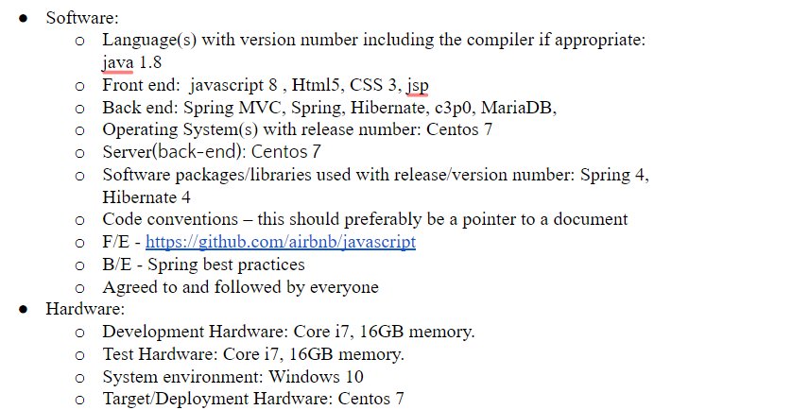

Slide 3
